Slide 1


Ranui School Mediators
Helping make Ranui Primary a
HAPPY, HEALTHY, HARMONIOUS AND HIGH ACHIEVING SCHOOL
With RESPECT being at the heart of everything we do

Slide 2

introduction
The Cool Schools Peer Mediation was first introduced to Ranui School in the 4th term in 2009
Special thanks to the
The Peace Foundation for helping make our school the place it is today

Slide 3

In the beginning.....
In 2009 we identified that in our playground we were seeing:
Unsafe behaviour modelled by senior students
Unhappy teachers not wanting to do duties
Students in groups being threatening
Students of all ages getting hurt
Bullying behaviour
Sad kids ☹

Slide 4

In our classrooms we had..........
Students unable to settle after break time
Students bringing in issues from lunch and playtime disagreements
High number of children in sick bay
Disrupted classrooms (particularly after lunch)
Learning being affected by behaviour
Unhappy teachers and students

Slide 5
So.... We decided to enlist the help of the peace foundation and bring the cool school mediation programme to ranui school

Slide 6
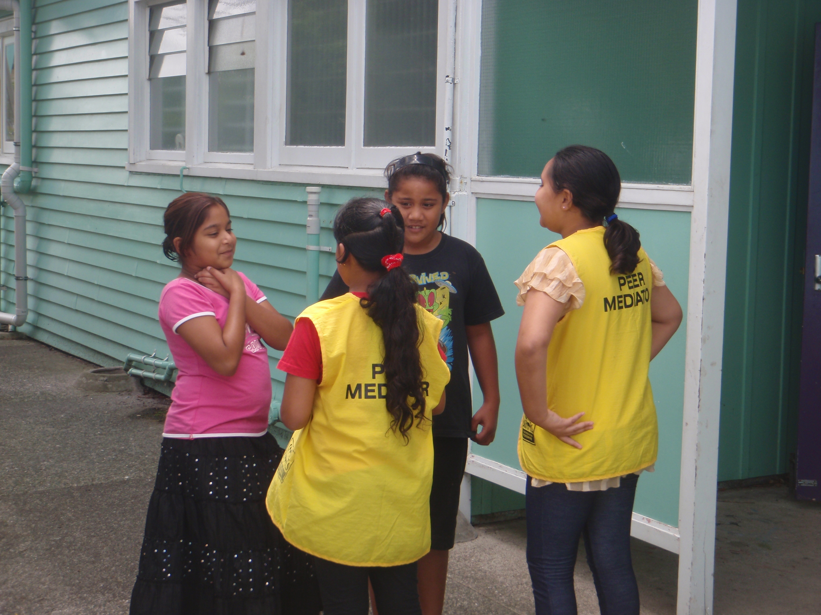
Students applied to be mediators and we began our training – the training needed to be meaningful and fun ...

Slide 7
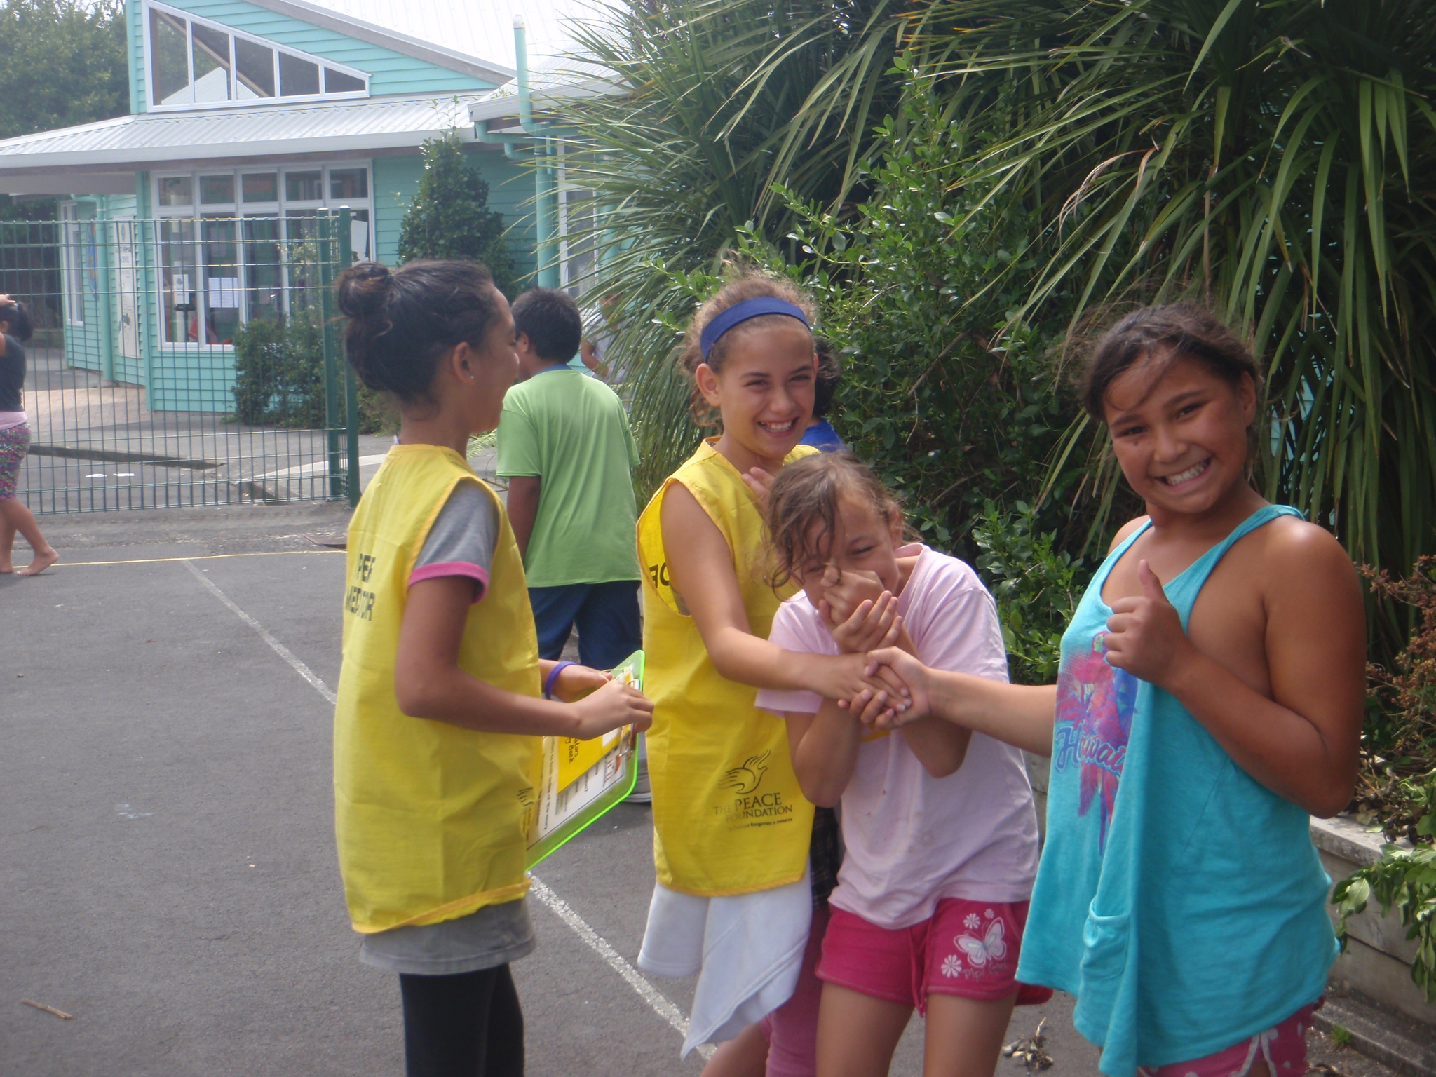
We had lots of fun doing our role plays

Slide 8
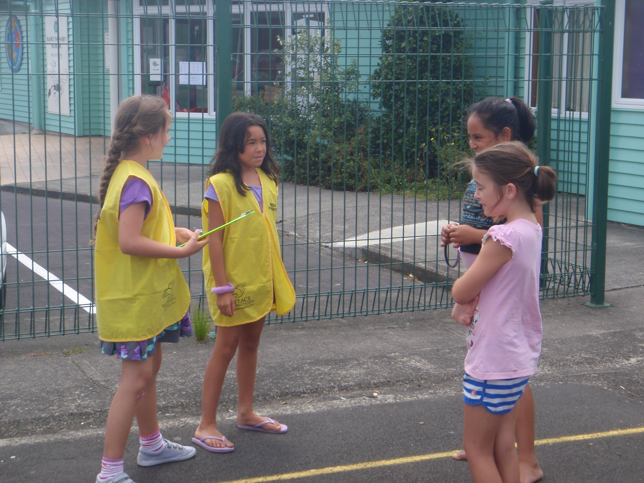
We all took turns to act and to be mediators – it was cool fun

Slide 9
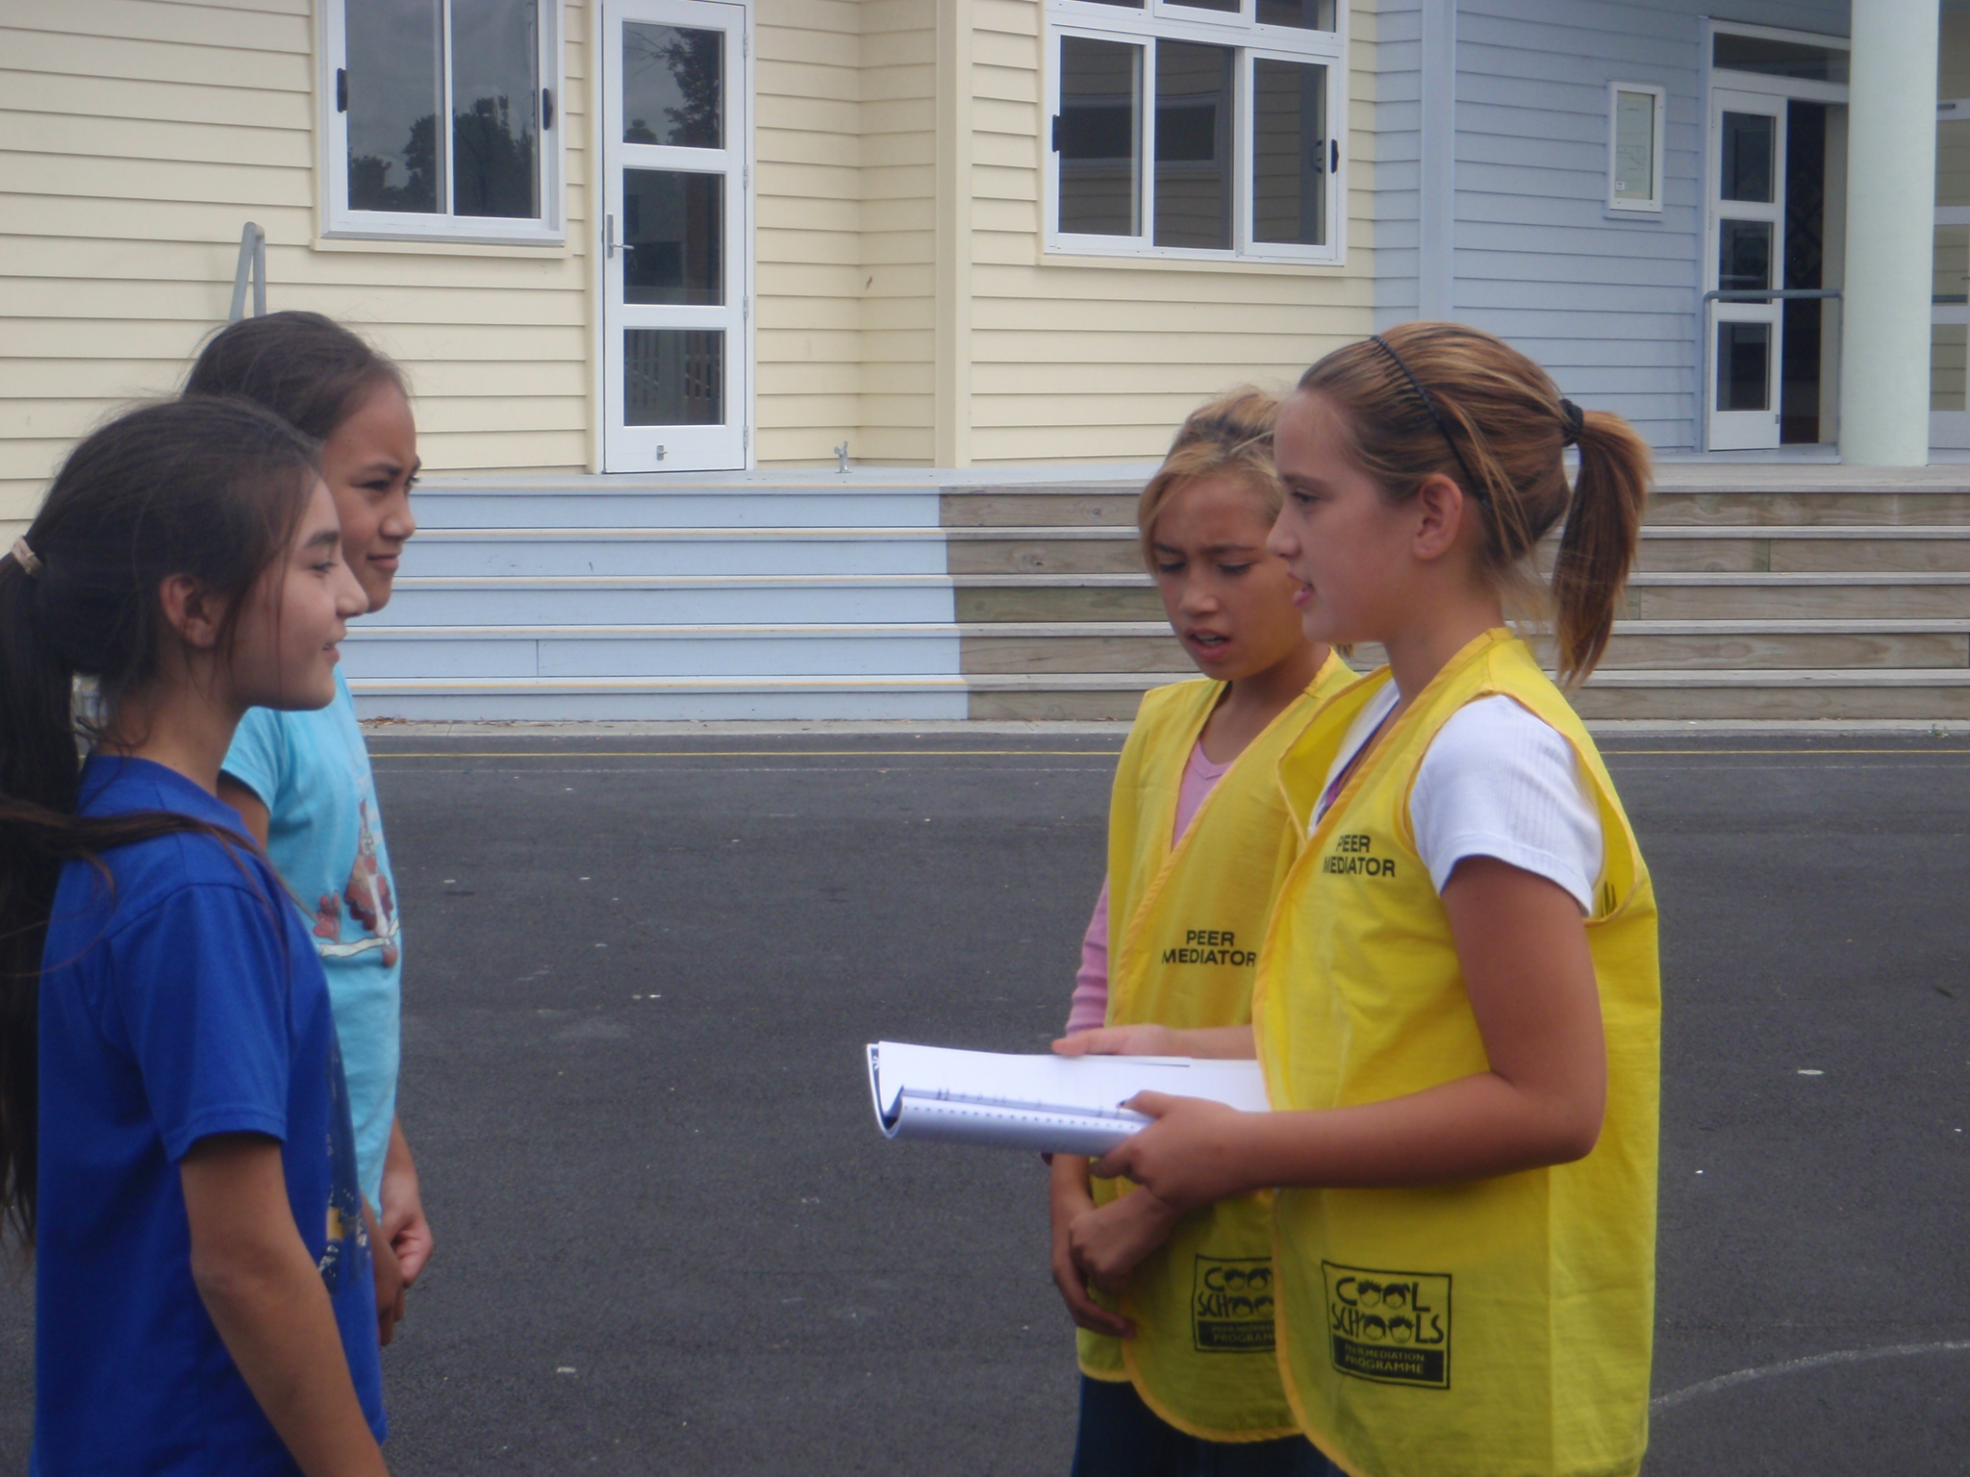
We learnt how to be good listeners and actively reflect what we had heard

Slide 10
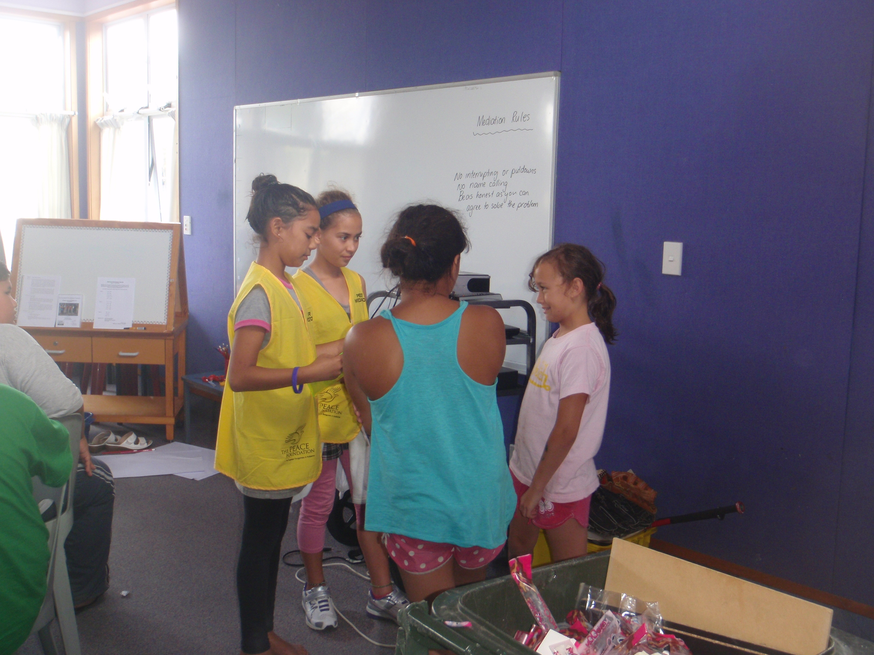
We practiced and practiced and practiced because we want to be the best mediators ever.

Slide 11
That was 4 years ago....
3 years ago ... our school was also accepted onto the pb4l contract.

Slide 12
Last year we did a survey to see how well the mediator programme and PB4L was working in our school.....

Slide 13
Mediator support
Mediators meet each Monday at Morning tea to talk over how their week has been, brainstorm ideas, get support and continue their mediator training. We discuss what is working well and not so well....
These are the results of our survey last year

Slide 14
Feedback from 2012
Mediators
What worked well?
Hardly any bullying now happening in the playground
Children showing respect to each other
Love wearing the jackets
Feel pride in helping Ranui School
Peace week was awesome when we washed the teachers cars and did the chalk art with the whole school.
Really enjoyed making jelly for all the classes.
Felt important and PROUD to be a MEDIATOR
Good timetable – LIKED BEING IN DIFFERENT AREAS OF THE SCHOOL
Monday morning mediator tea parties – good way to keep motivated – Whaea Del giving us treats every Monday.

Slide 15

Feedback from 2012
Mediators
What didn’t work well?
Sometimes just wanted to go and play with mates
Big students sometimes making up pretend problems
Little children wanted to keep holding my hand (boys)
Getting back to class late sometimes due to having to sort a problem then getting a growling cause we were late back.
Sometimes teachers not being around to help us sort out bigger problems. We couldn’t see them on duty so didn’t know where to get help from.

Slide 16
We have a duty timetable

Slide 17
Training includes
Active listening
Using “I” statements
Recognising different ways of dealing with conflict
Dealing with aggression

Slide 18
Open and closed questions
Role of the mediator
The conflict mediation process
Handling difficult situations

Slide 19
As our problem behaviours were getting less in the playground – we introduced a reward system to support good behaviour choices

Slide 20
Rewarding children who are spotted doing the right thing

Slide 21

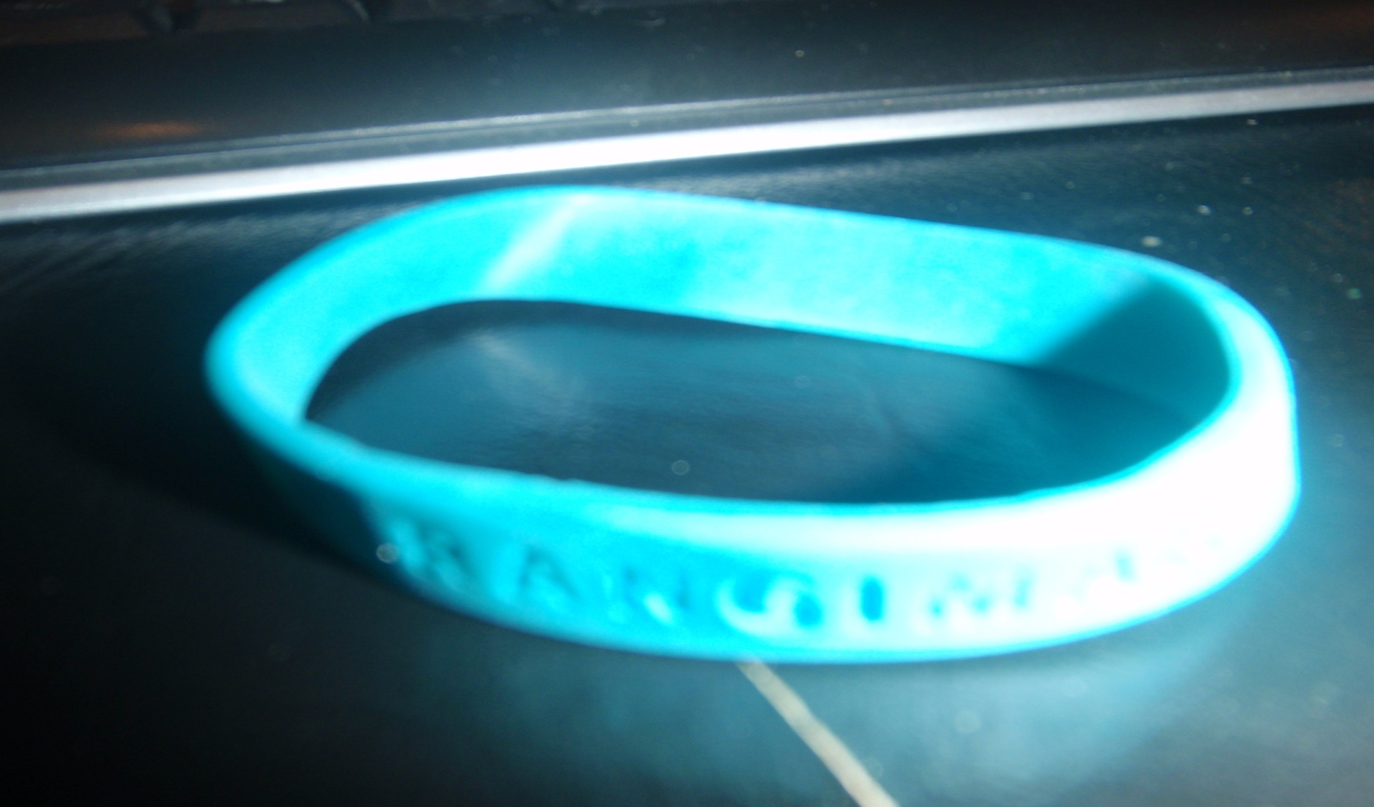
Once upon a time
In a playground near to you

Slide 22
Walked 30 awesome mediators
Looking for something to do

Slide 23
The children were all laughing
Playing nicely with their mates

Slide 24
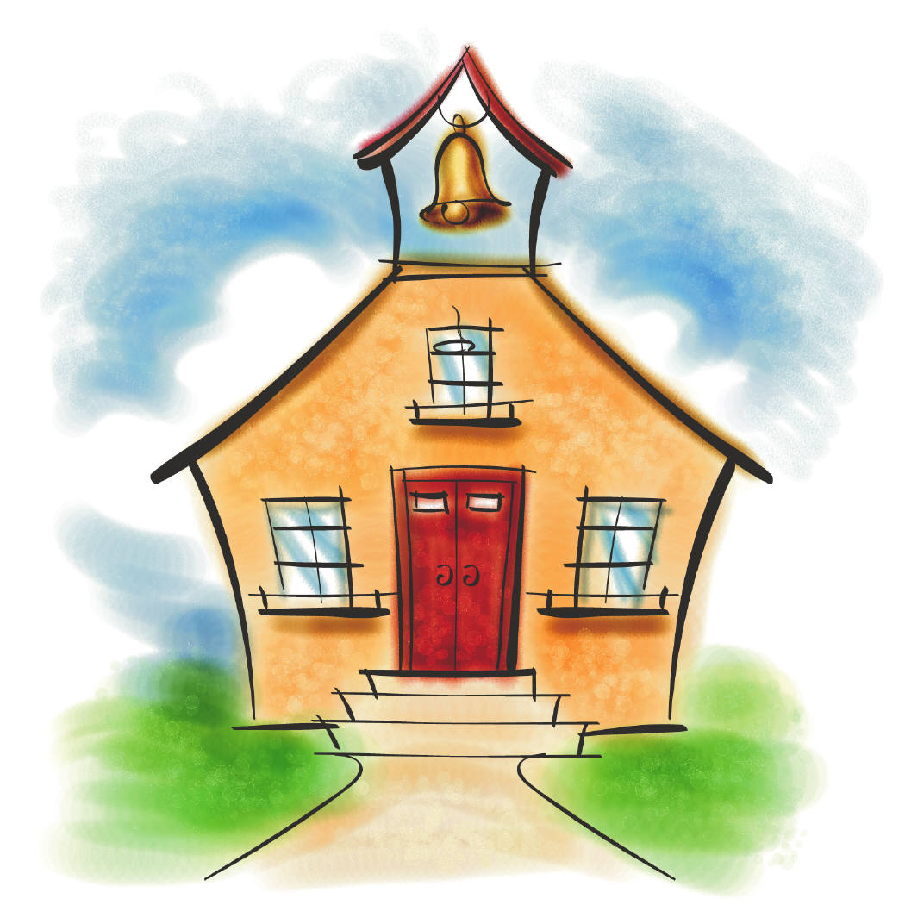
Some were picking flowers
And swinging on the gates

Slide 25
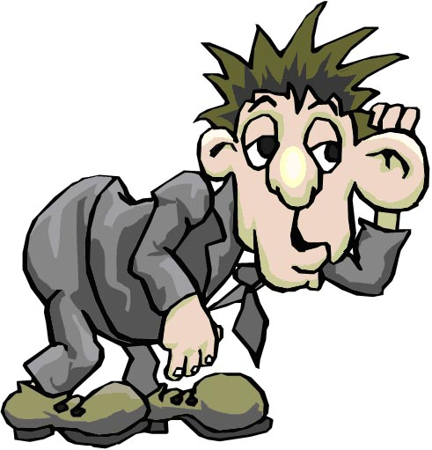
“We want to say well done
We want to make them hear……

Slide 26
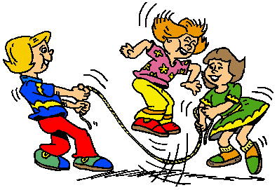
“ Ranui kids are awesome”…
You could hear the mediators cheer

Slide 27
So the mediators went shopping
To see what they could find

Slide 28
To say well done to the children
For being really kind

Slide 29
And then they found a wristband
That had a message too

Slide 30
It said “Rangimarie”
Which means ‘Peace” to you

Slide 31

So here is the wristband
That you can earn at school

Slide 32
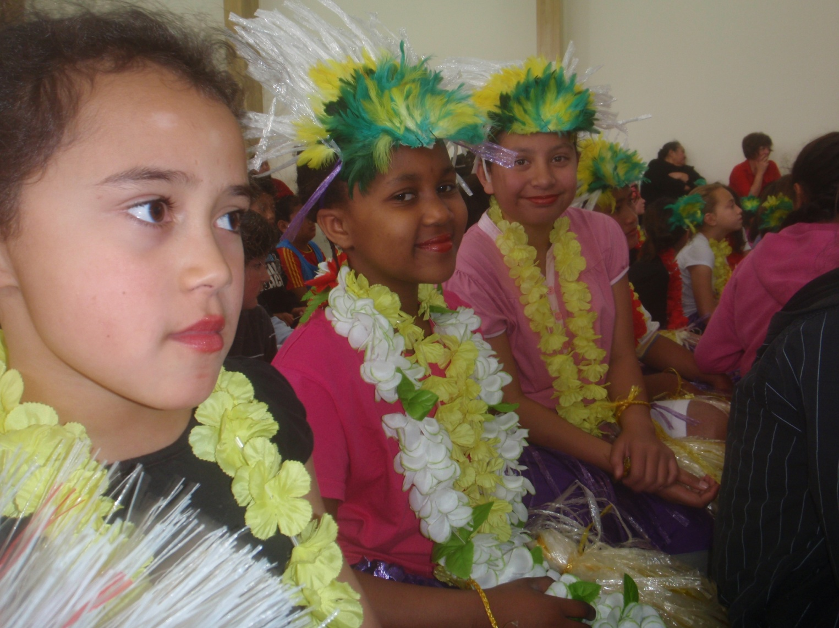
For making awesome choices
And being really cool

Slide 33
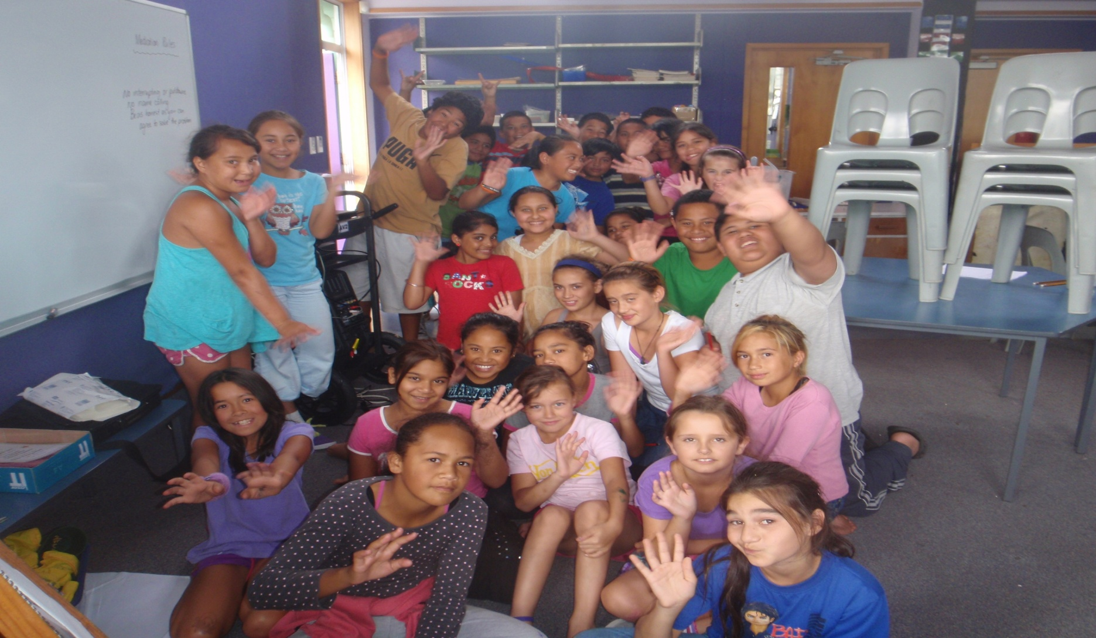
We hope you win a band
For playing really well

Slide 34
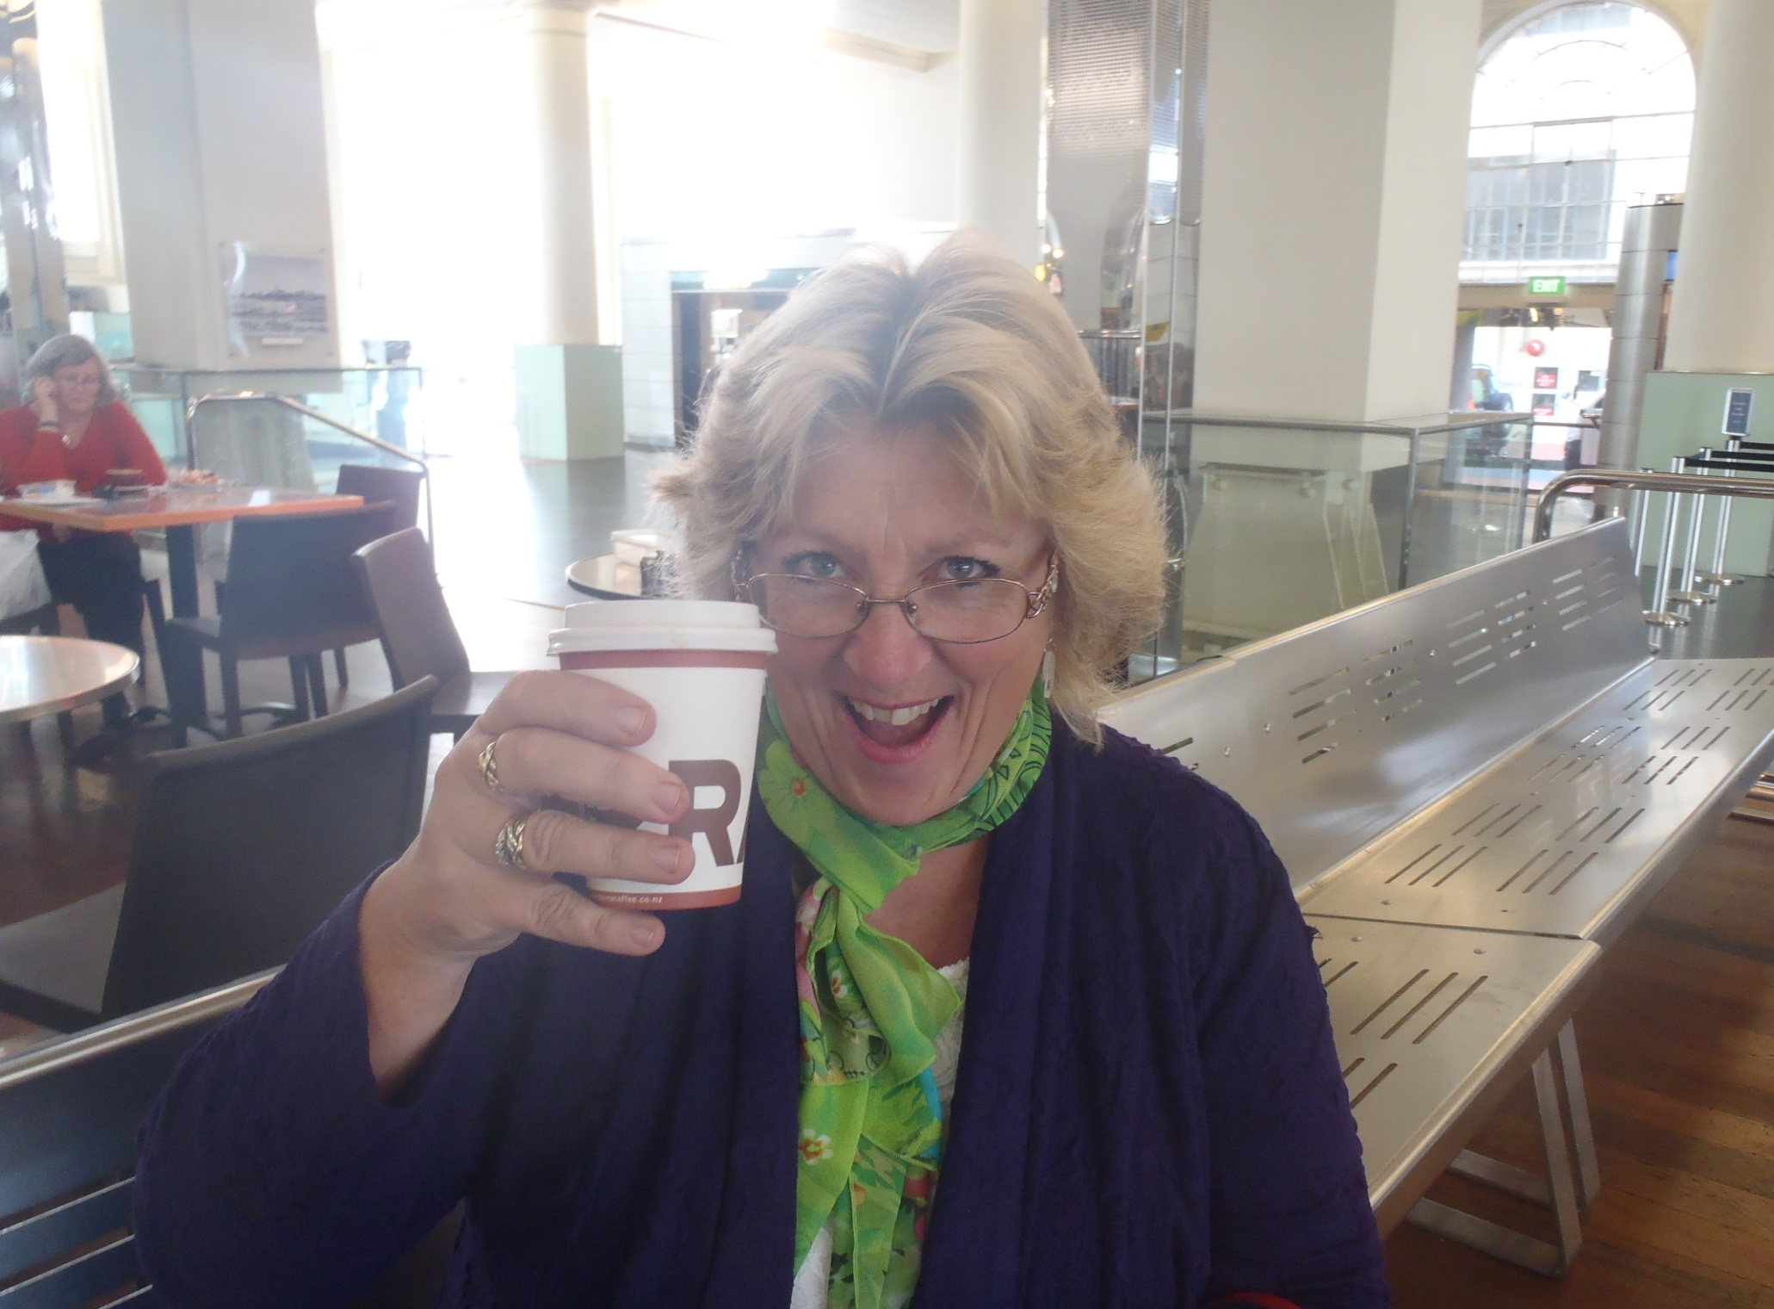
Go and show your teacher
And smile at Whaea Del

Slide 35
Peace Bands are cool
Wear them every day…

Slide 36
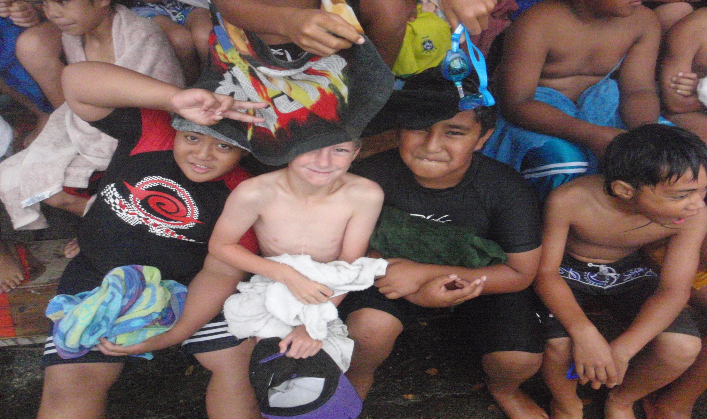
Show Ranui children…
That YOU know how to play

Slide 37

We have introduced the “golden ticket” for class prizes.
We linked the golden ticket to our new school logo and our PB4L BEHAVIOUR GOALS

Slide 38
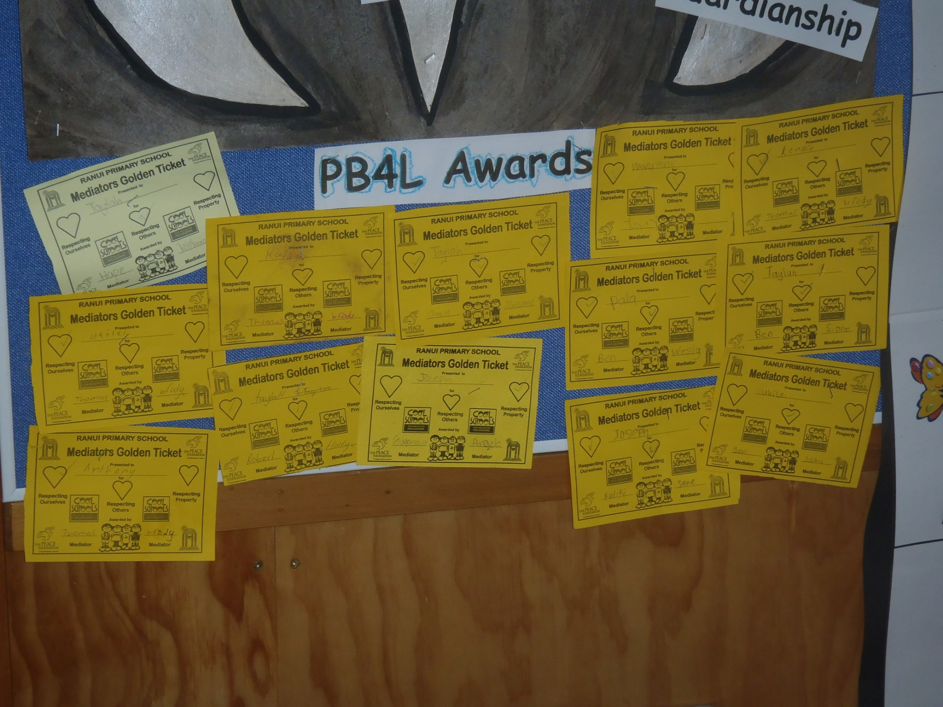
Golden tickets are displayed in the classrooms....
The class with the most Golden tickets at the end of the month gets a special treat from the mediators

Slide 39
We have changed our mediator uniform from....

Slide 40
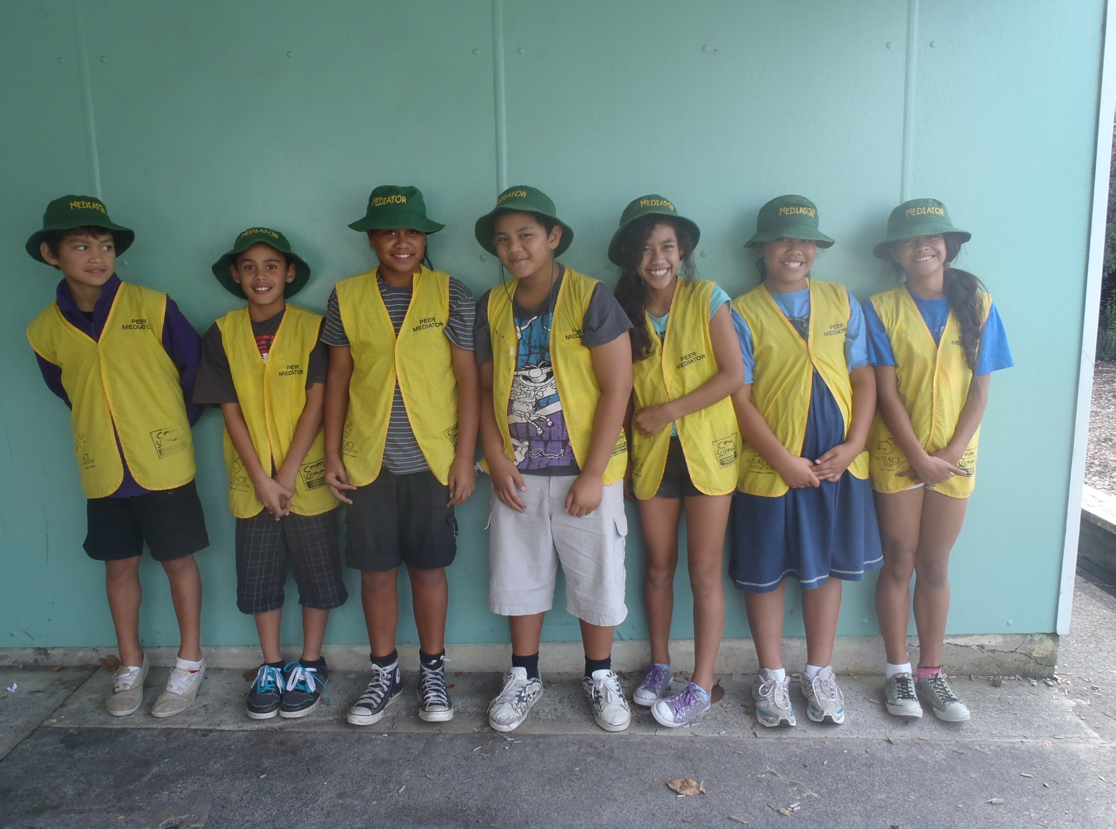
the yellow mediator vests to....

Slide 41
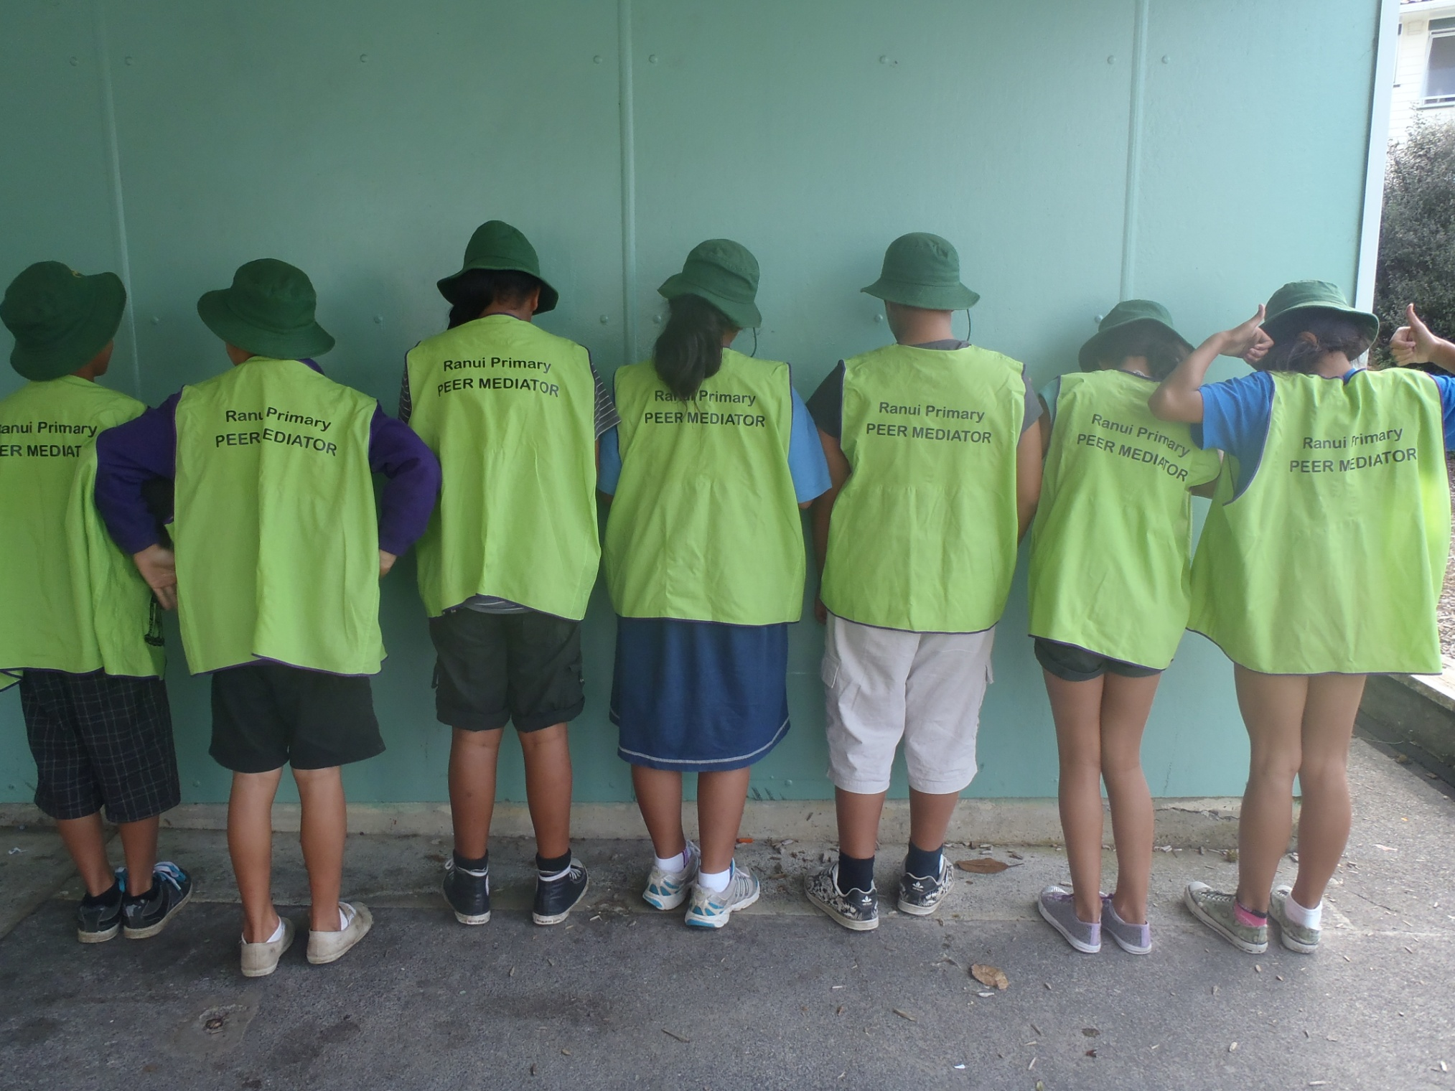
lime green vests with Ranui School on and ....

Slide 42
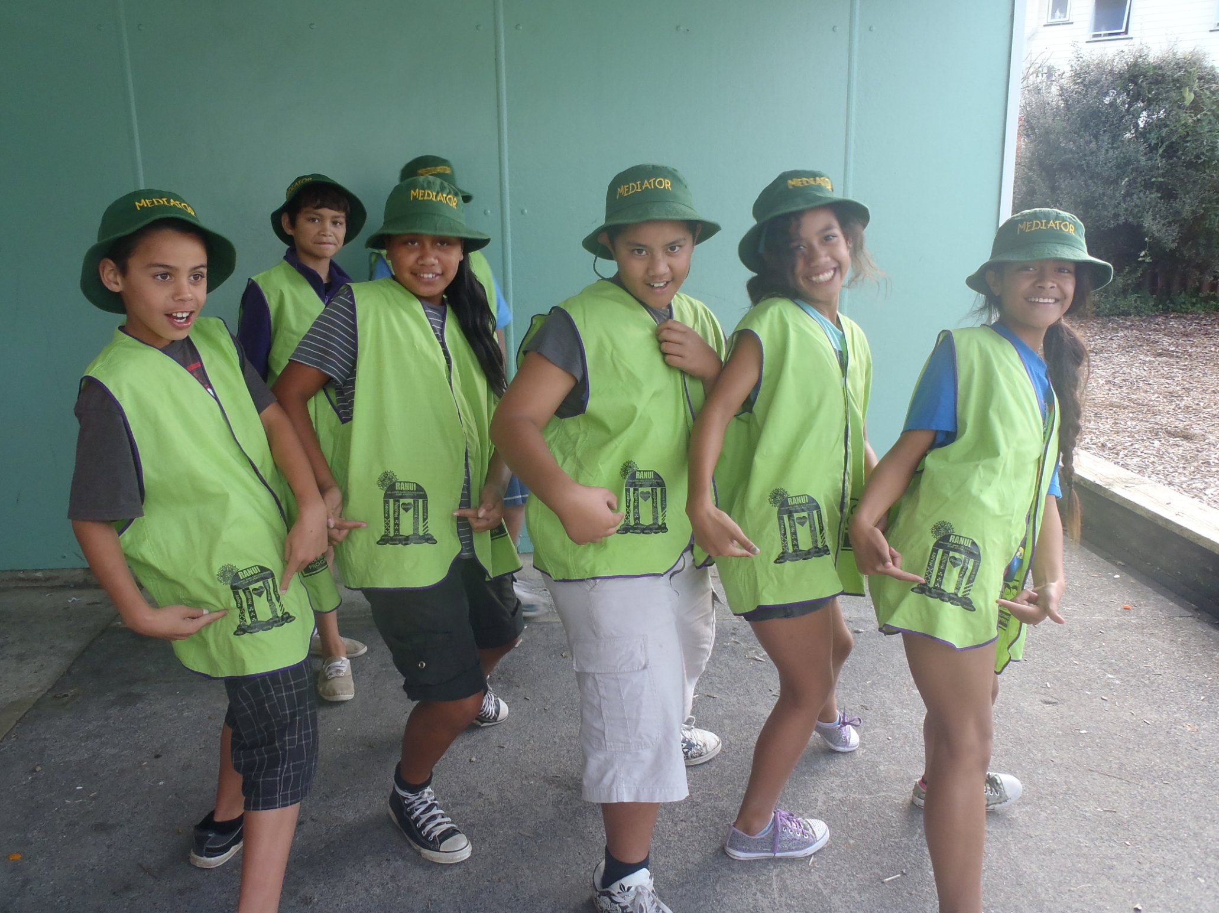
our school ‘Fale of learning’ on the front....

Slide 43
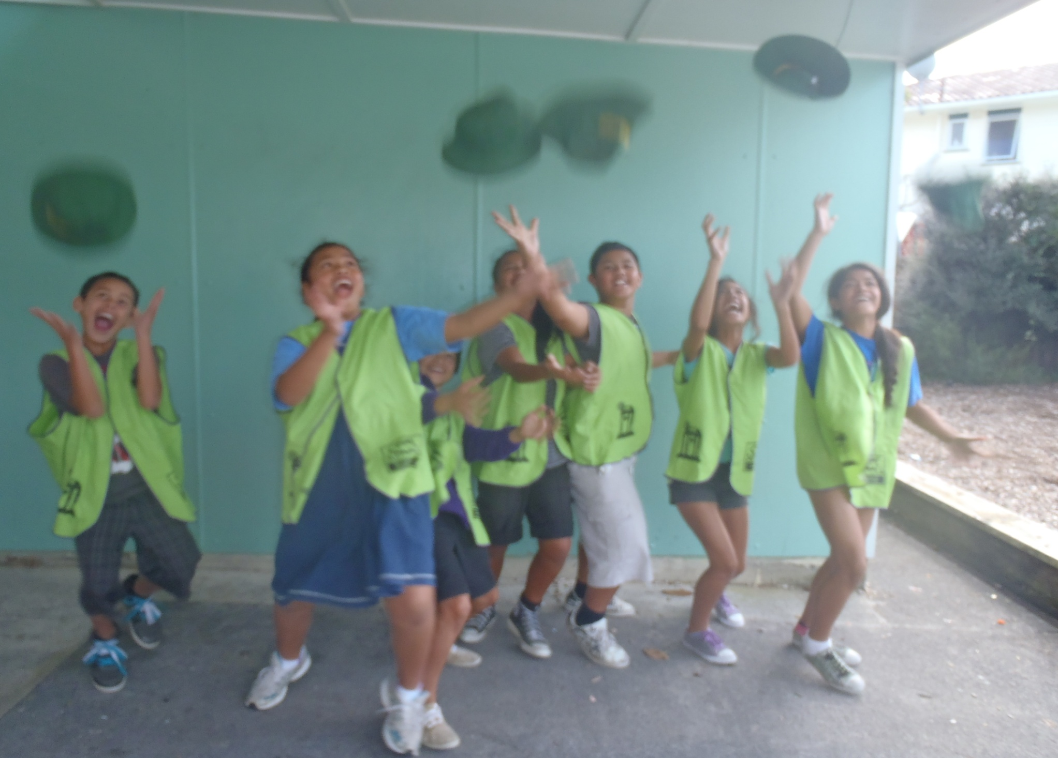
We are getting new purple hats to match our school uniform

Slide 44
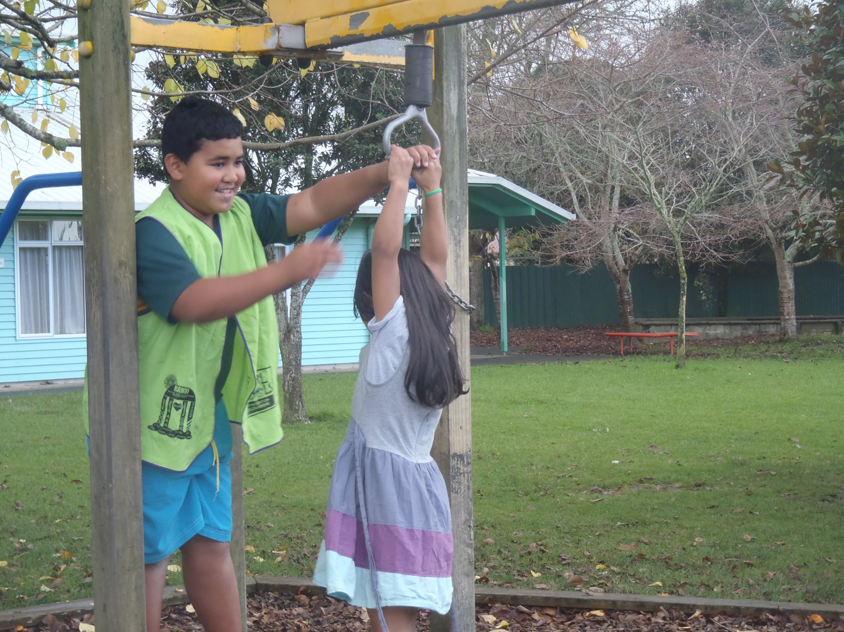

Our mediators now help students be safe in the playground ... like on the flying fox

Slide 45
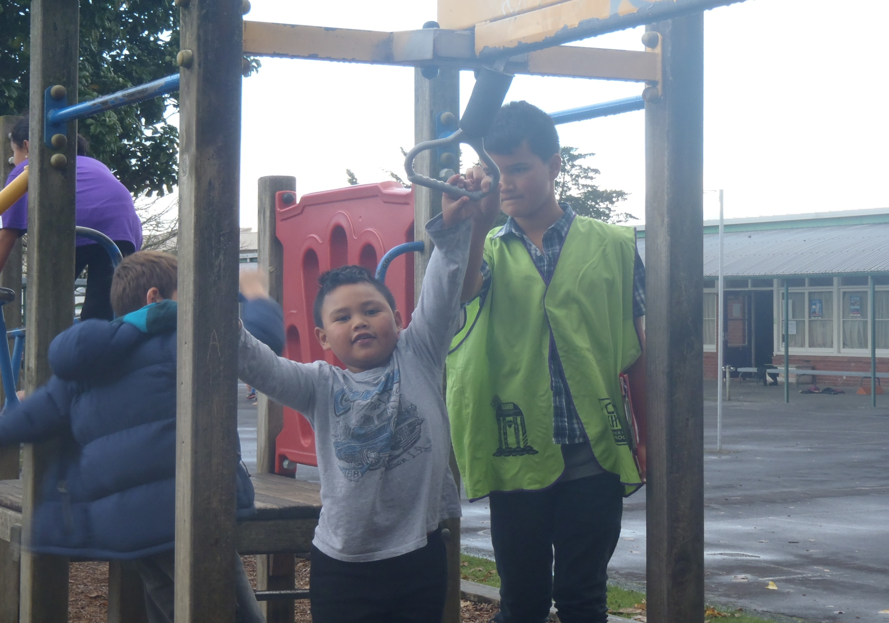
Tuakana are looking after Teina

Slide 46
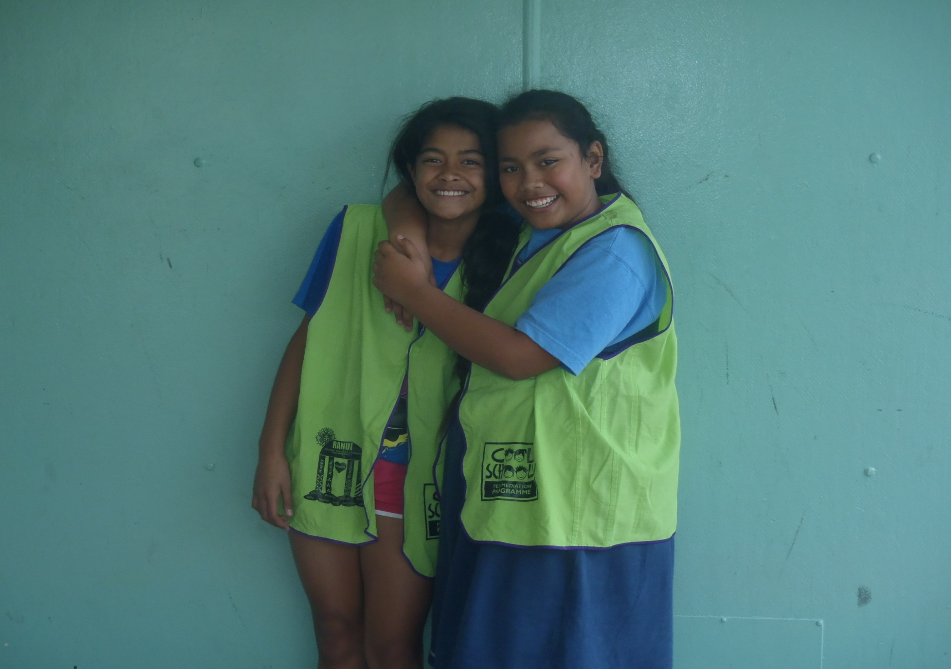
Ilaisaane and Rebekah are our head mediators – they help Whaea Del make sure everyone is out on duty each day

Slide 47
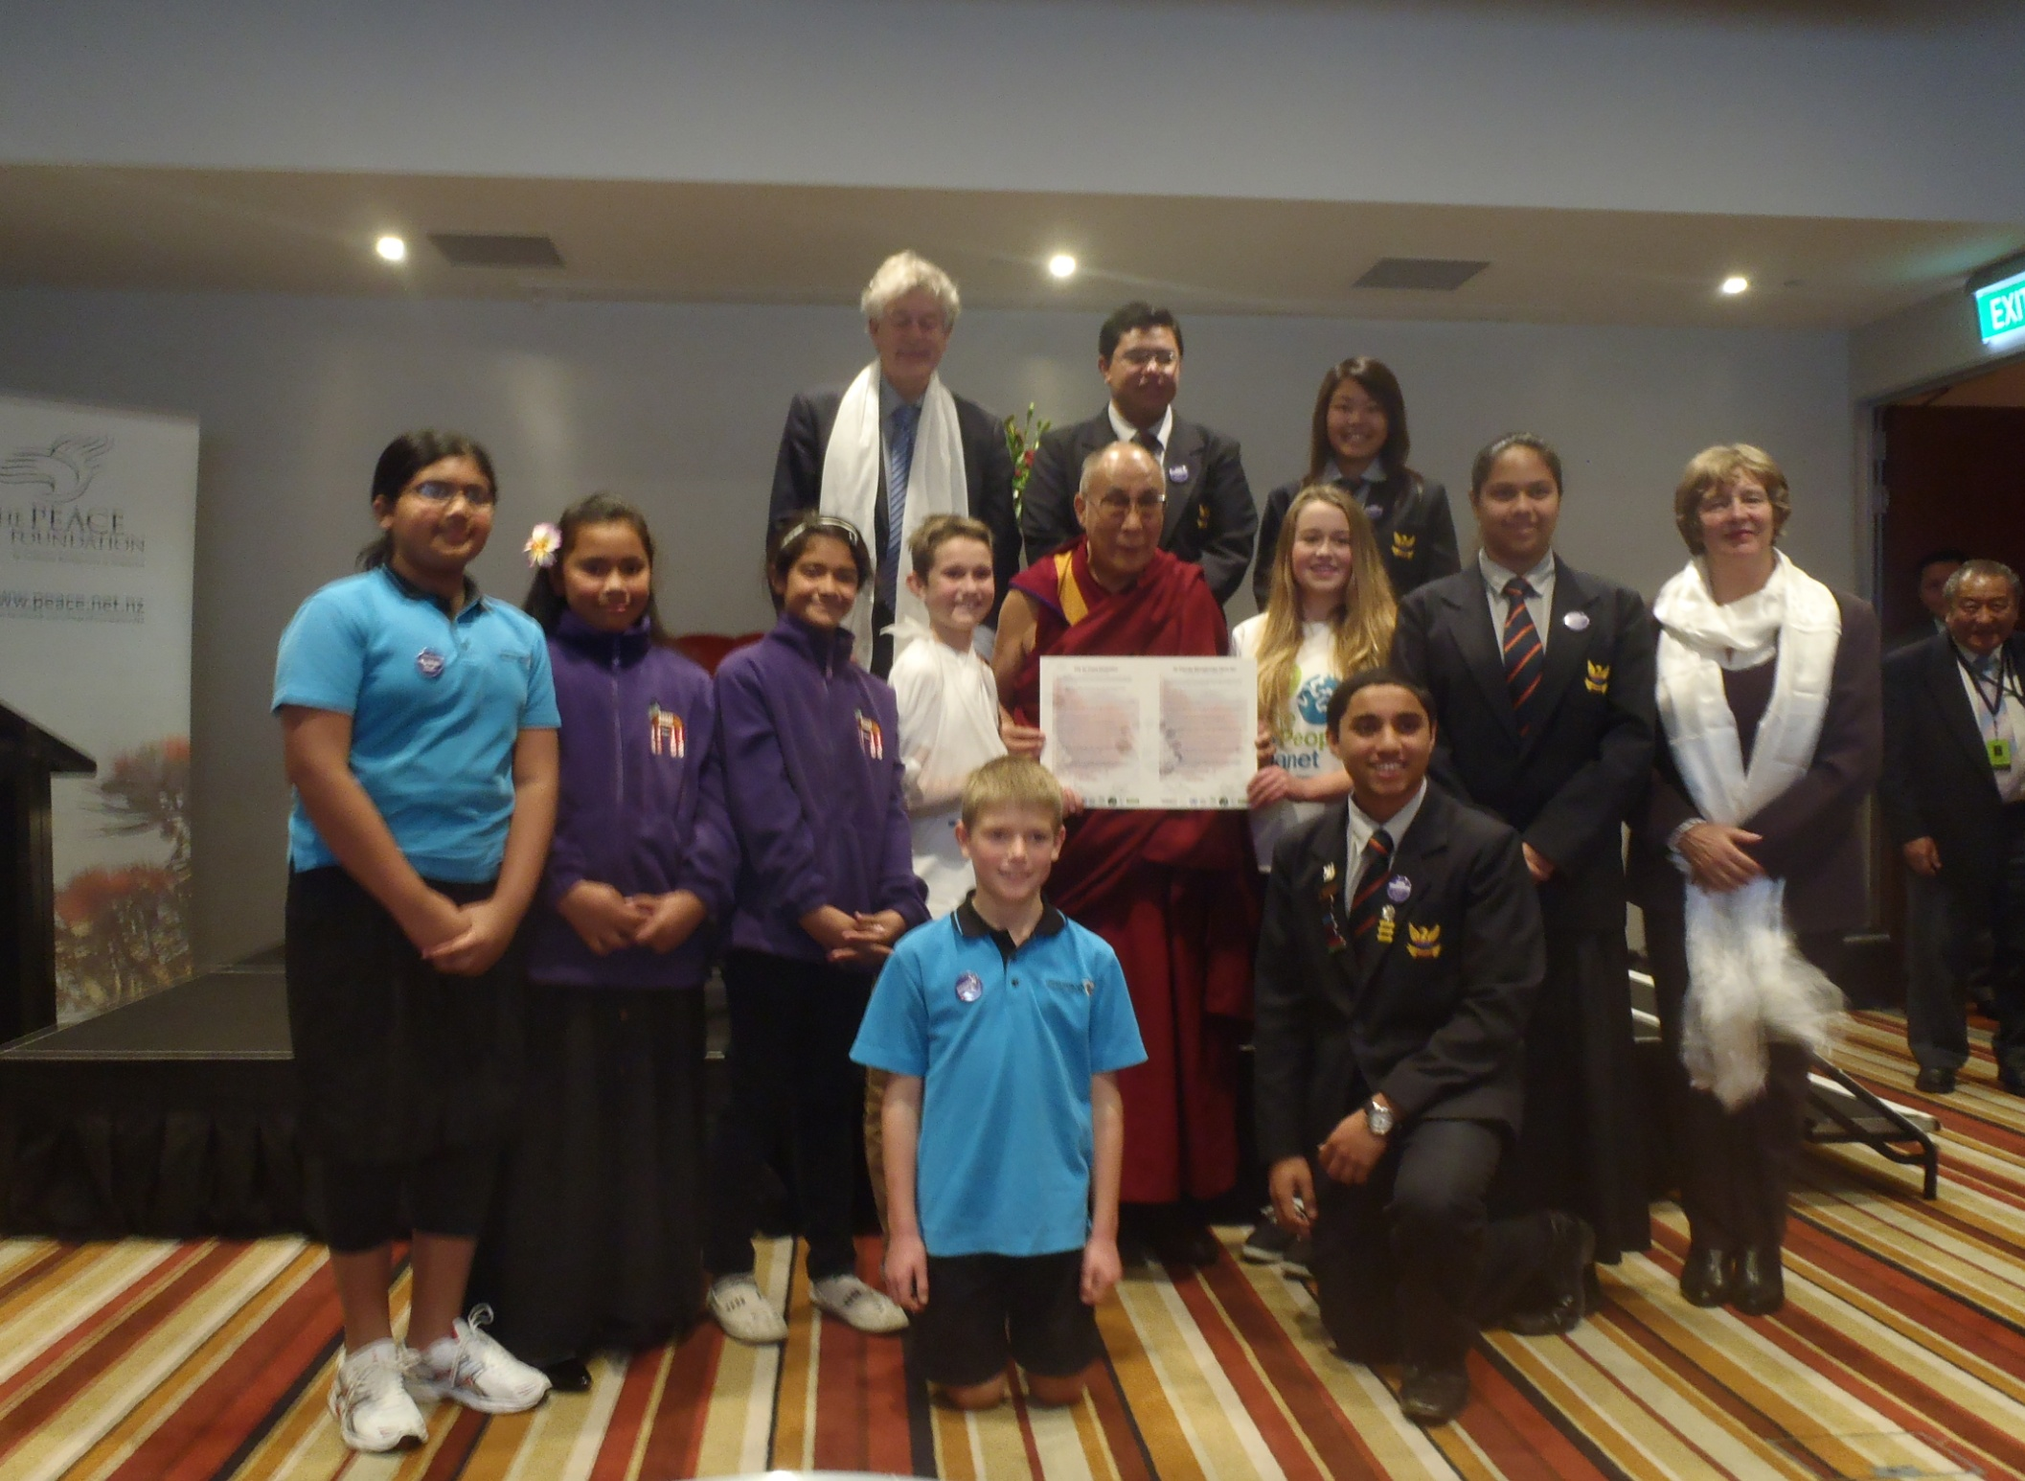
Ilaisaane and Rebekah met His Holiness the 14th Dalai Lama last week with the Peace Foundation
That was an incredible experience and one we will remember always.

Slide 48
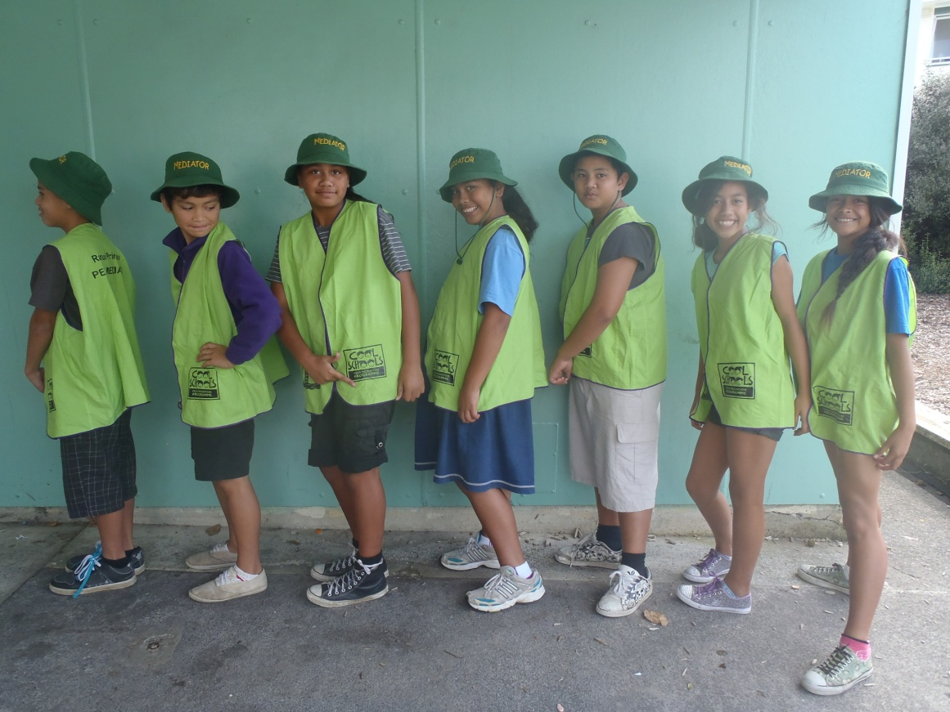
Ranui school Mediators are wonderful role models to all our Tamariki.

Slide 49
we are learning to be ........... ....
“happy, Healthy, Harmonious and high achieving with respect at the heart of all we do and say

Slide 50
Presented by
Ranui Mediators....
Ilaisaane
Rebekah
Robert
Eden

