Slide 1
Peer Mediator Presenters - Amber, Charlotte, Eden, Thomas

Slide 2
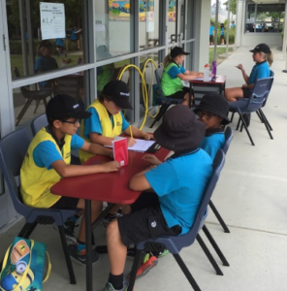
Where are we at with Peer Mediation at UHPS?
How long has our team worked together?
Selection?
Teacher involvement?
Meetings?
Training?

Slide 3
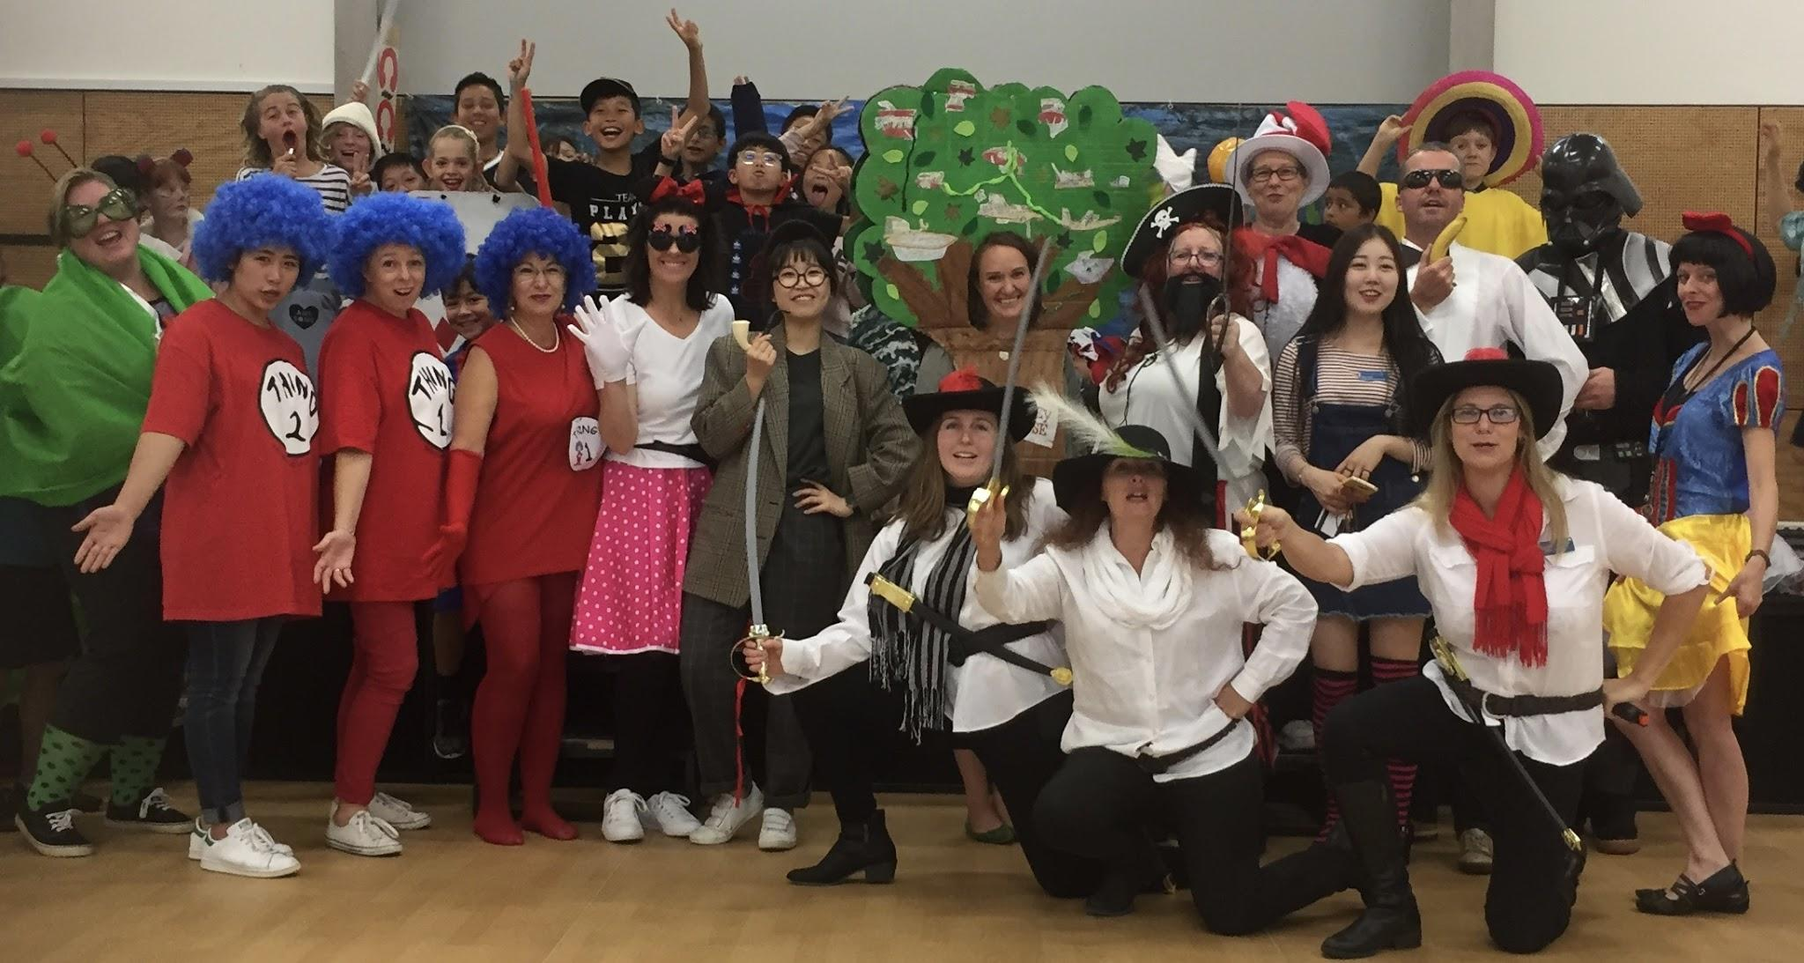
What sort of problems do you help with when you are on duty as a Peer Mediator?

Slide 4
What is working well with our Peer Mediation Programme?
Peer mediators take a lot of weight off our teachers by helping to sort out other children's problems.
Peer mediators coming to meetings
People are getting help from us with their problems
Everyone getting to do a duty
Making sure other fellow peer mediators are doing their duties
Making sure we're not handling physical problems

Slide 5
How does Peer Mediation integrate with other aspects of school life?
It helps by learning how to solve problems and to do only responsible things
Making new friendships and Building connections
By doing the right things and using manaakitanga to other people
respect

Slide 6
peer-mediation-works
Peer Mediation with Ian and Thomas

Slide 7
Rewards
We have Bronze, Silver and Gold awards this is the sheet we get to complete these awards. There is one more award the Peace Ambassador award we had 6 people who got that award last year, we earn this award by leaving something in the school or leaving a message.
Peer mediation award sheet

Slide 8
Any questions for our Peer Mediators?

